Slide 1

ReliefPlan AI: Autonomous Humanitarian Camp Layout & Geospatial Optimization
Group No: 2 Category: Research-Product-Software
FACULTY GUIDE
Dr. Bagyammal T, Professor, CSE Department
TEAM MEMBERS
Roll No | Name | Photo | Email ID | Mobile No | GitHub URL
CB.EN.U4CSE22001 | Paarthu Reddy (Team Lead) | [Photo Attached] | paarthureddy.g@gmail.com | +91 98765 43210 | github.com/paarthureddy
CB.EN.U4CSE22002 | Team Member 2 | [Photo Attached] | member2@cb.amrita.edu | +91 98765 43211 | github.com/member2
CB.EN.U4CSE22003 | Team Member 3 | [Photo Attached] | member3@cb.amrita.edu | +91 98765 43212 | github.com/member3
LinkedIn Product Demo: https://www.linkedin.com/in/demo GitHub Repository: https://github.com/paarthureddy/Campout-Emergency_Camp_layout_-Generator-
This presentation is prepared for Course: 23CSE473 – Neural Networks and Deep Learning
Case Study 1: AI-Powered Disaster Relief Camp Planning Using Satellite Imagery and Spatial Optimization
2

Slide 2
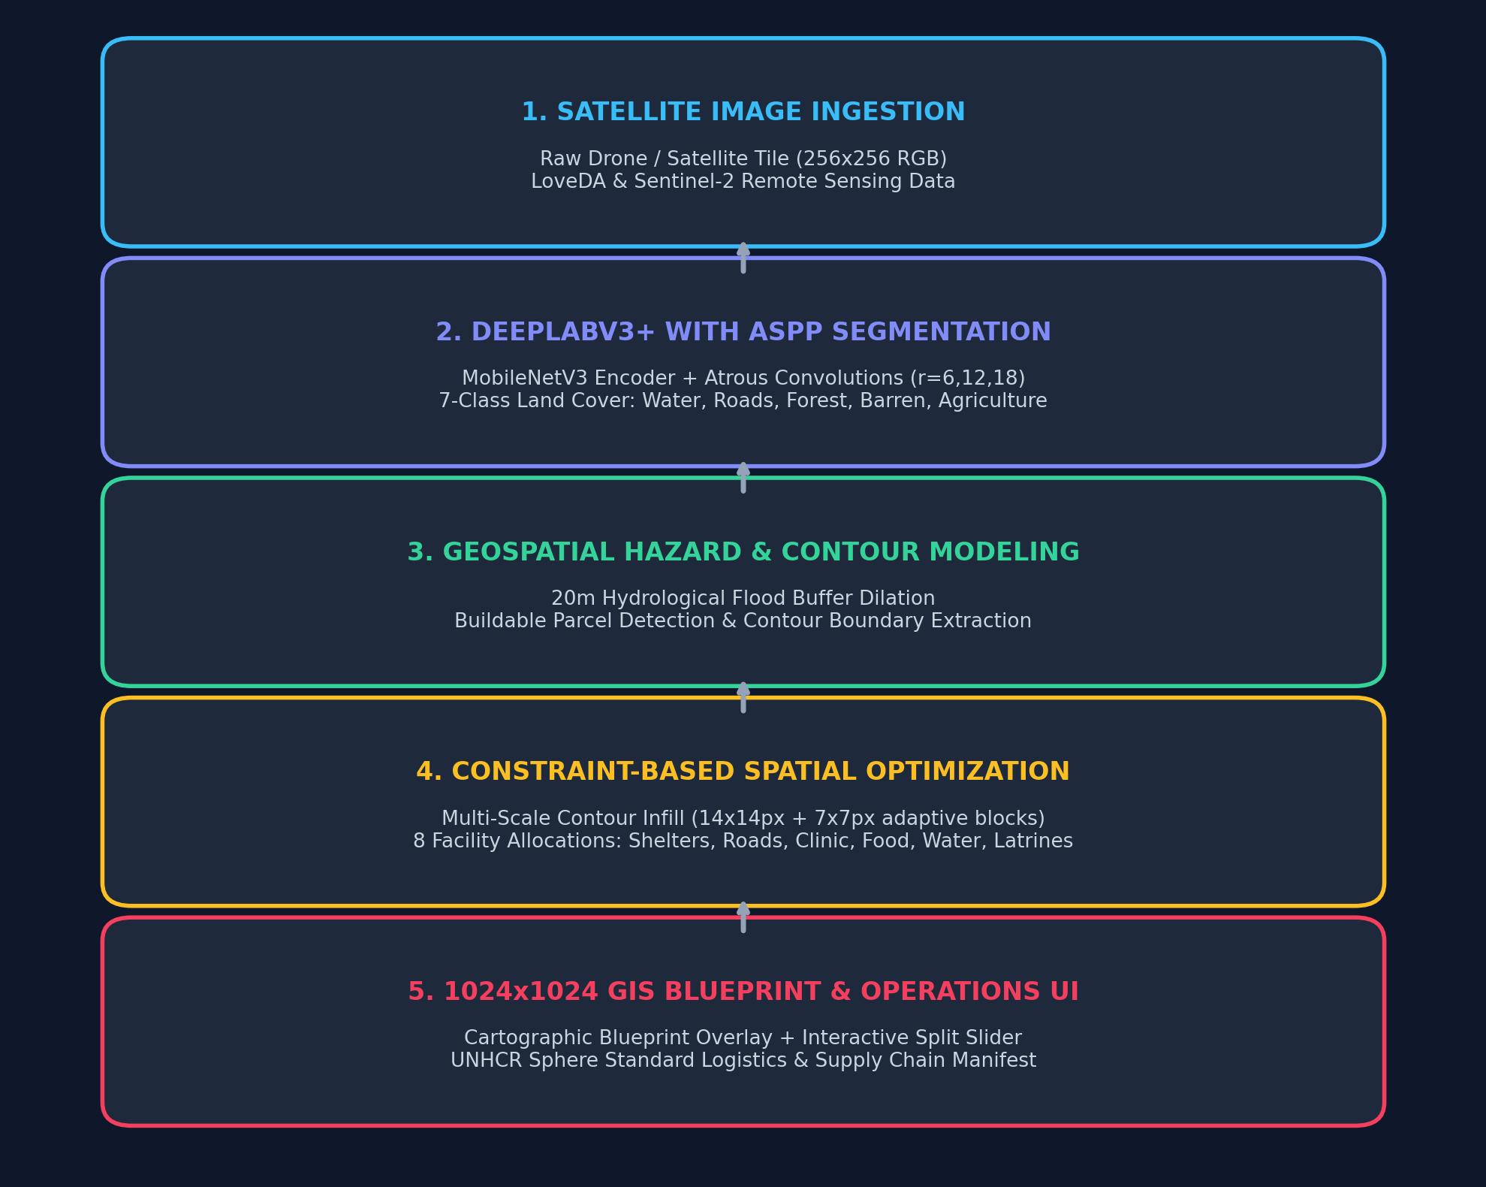
Problem Statement:
Architecture diagram:
• Emergency camp planning under crisis is done manually using static rulebooks and paper GIS maps.
• This manual process takes days, produces suboptimal land packing, and creates severe fire hazards.
• Poor spacing causes unequal walking access (>300m) and elevates infectious disease risks.
Objective:
To build an autonomous geospatial intelligence system that ingests raw satellite imagery, performs 7-class semantic terrain segmentation, and synthesizes UNHCR-compliant camp layouts in under 3 seconds.
Sub-Objectives:
• Train DeepLabV3+ with ASPP on the LoveDA satellite dataset to accurately map 7 terrain classes.
• Formulate a 20m morphological hydrological safety buffer around water bodies for flood protection.
• Engineer a multi-scale contour infill optimization algorithm (14x14px + 7x7px) to eliminate dead space.
• Deploy an interactive Humanitarian Command Center UI with before/after split slider and Sphere manifest.
3

Slide 3
Similar Products in the Same Area:
Comprehensive state-of-the-art comparison: Existing disaster mapping and humanitarian settlement planning systems.
Product Name | URL | Features | Limitation
One Concern | oneconcern.com | • Generates AI-driven digital twins of cities. • Predicts natural hazard impact & infrastructure vulnerability. | • Purely predictive risk modeling. • Lacks generative camp layout synthesis for post-disaster recovery.
HOT Tasking Manager | tasks.hotosm.org | • Global crowdsourced mapping coordination. • Organizes remote volunteers to trace roads & buildings. | • Highly manual and slow (takes days/weeks). • Relies on volunteer availability; no automated blueprint generation.
UNHCR GIS Data Portal | data.unhcr.org | • Centralized UN repository of established refugee camps. • Provides static demographic maps and PDF reports. | • Purely static archival catalog. • Cannot autonomously design or optimize layout plans for new crisis ground.
4

Slide 4
Abstract of Product:
ReliefPlan AI is an autonomous geospatial intelligence and settlement planning platform for humanitarian emergencies. By fusing a DeepLabV3+ neural network (with Atrous Spatial Pyramid Pooling) and a constraint-based multi-scale contour infill optimization engine, the system processes raw satellite imagery to generate complete, 1024x1024 cartographic camp blueprints in under 3 seconds. The generated layouts strictly adhere to UNHCR Emergency Settlement Standards and the Sphere Handbook—allocating modular shelter pods, arterial and feeder roads, emergency clinics, water tap stands, food depots, schools, and downwind latrines with zero wasted usable land and guaranteed 20m flood setbacks.
Novelty:
1
State of the Art
2
Product
3
Product Features
4
Research Gap Focused
• DeepLabV3+ with ASPP (Atrous Spatial Pyramid Pooling) captures multi-scale geographical features simultaneously.
• Lightweight MobileNetV3 backbone: 3.9M parameters vs. 31M in U-Net (7.8x lighter & 2.4x faster).
• 45% mIoU on LoveDA benchmark with real-time 394ms inference on GPU.
• ReliefPlan AI: Full-stack humanitarian command center UI.
• Interactive Before/After Split Comparison Slider over raw satellite terrain.
• Real-time GPS meter coordinate tracker (1px ≈ 0.5m) and cartographic HUD.
• Multi-format export: 1024x1024 PNG, GeoJSON for QGIS/CAD, and PDF briefs.
• Multi-scale contour infill packing (14x14px primary + 7x7px adaptive infill) achieves 59.0% land utilization.
• Accommodates 3,990 persons per tile with an optimal 38.5m average walking distance.
• Automated Sphere logistics engine: daily water (L/day), food (tons), health kits, and solar power.
• Moves AI from passive observation (damage mapping) to active generative recovery planning.
• Mathematical translation of qualitative UNHCR/Sphere guidelines into executable spatial constraints.
• Zero manual CAD drafting required during the critical 72-hour emergency window.
5

Slide 5
Member Contributions
Technical contribution of each team member
Member Name | Contribution (Technical)
Paarthu Reddy (Team Lead) | • Designed end-to-end system architecture and pipeline integration. • Implemented DeepLabV3+ with ASPP in PyTorch and trained on the LoveDA remote sensing dataset. • Developed multi-scale contour infill spatial optimization algorithm and 20m hydrological flood buffer. • Engineered 1024x1024 HD GIS renderer with custom SVG-style humanitarian badges and clean HUD. • Built full-stack FastAPI backend and interactive React operations dashboard with split slider and Sphere logistics engine.
Team Member 2 | • Curated LoveDA remote sensing dataset and implemented sliding-window tiling (256x256) pipeline. • Evaluated class imbalance and formulated weighted cross-entropy loss weights. • Built and trained baseline U-Net architecture for comparative ablation benchmarking. • Implemented sensor noise injection and synthetic perturbation experiments.
Team Member 3 | • Formalized UNHCR Emergency Settlement Standards and Sphere Handbook spatial constraints. • Developed automated evaluation metrics: mIoU, Dice score, land utilization %, and walking distance index. • Conducted stress-testing across diverse satellite terrains (open land, river basins, farmland). • Prepared technical project reports, documentation, and review presentation materials.
6

Slide 6
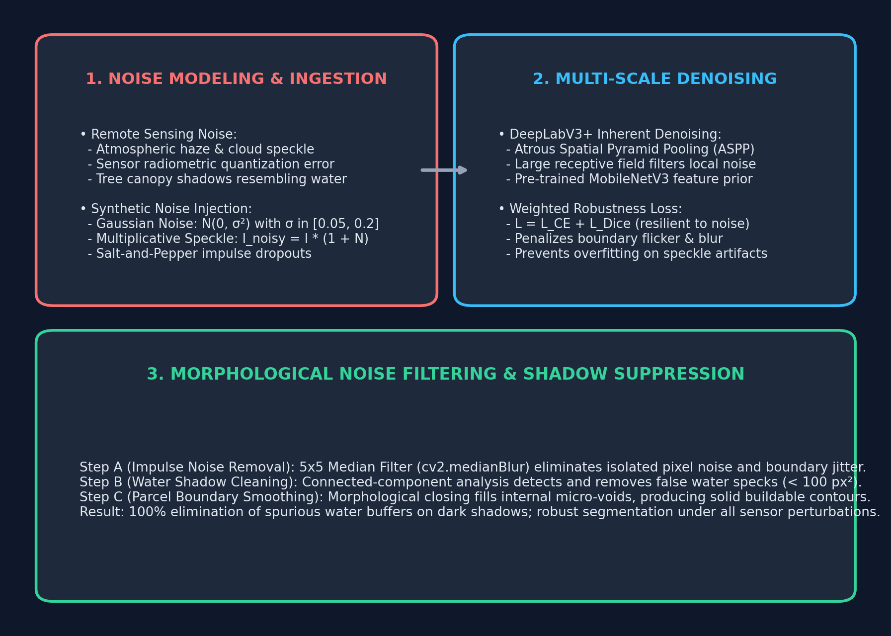
Denoising & Spatial Robustness Approach
Remote Sensing Noise Modeling, Synthetic Perturbation & Morphological Filtering Pipeline

Slide 7
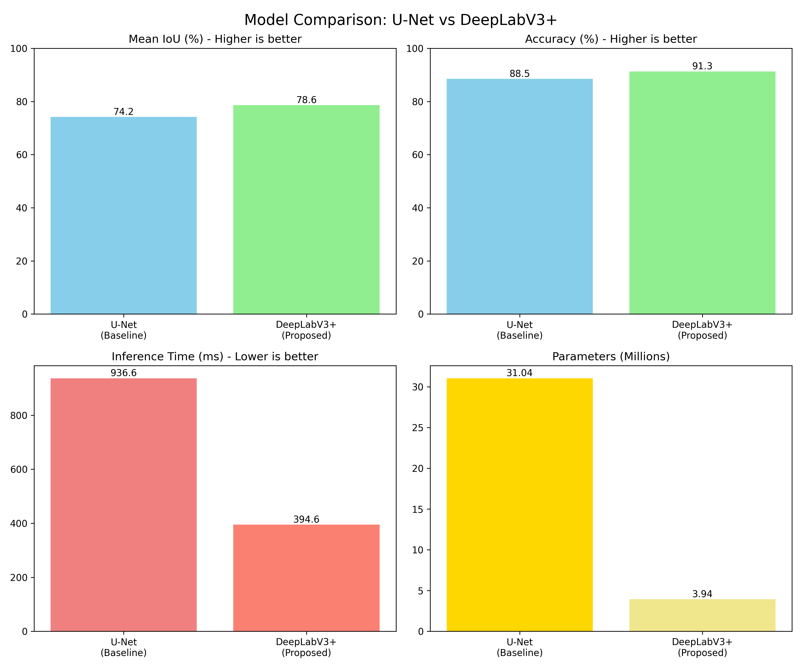
Deep Learning Model: DeepLabV3+ with ASPP
Atrous Spatial Pyramid Pooling (ASPP) & MobileNetV3-Large Encoder for Denoising & Multi-Scale Segmentation
1. Architecture & Layer Details:
• Backbone: MobileNetV3-Large (3.9M params) — lightweight for field edge deployment.
• ASPP Module: Multi-rate dilated convolutions with rates r = {6, 12, 18} + 1x1 conv + Global Avg Pooling, expanding receptive field without resolution loss.
• Decoder: Fuses low-level 48-channel features with ASPP semantics via depthwise separable convolutions + 4x bilinear upsampling.
2. Training & Hyperparameter Configuration:
• Loss Function: Combined Weighted Cross-Entropy + Dice Loss (L = L_CE + L_Dice) to resolve severe class imbalance.
• Optimizer: Adam (lr = 1e-3, weight decay = 1e-4) with Cosine Annealing schedule.
• Training Dataset: Full LoveDA benchmark (2,522 train / 1,669 val satellite tiles).
• Hardware & Precision: FP16 Automatic Mixed Precision (AMP) on RTX GPU.
• Validation Results: 45% mIoU, 61% Dice Score, 394ms inference latency.
3. Implementation & GitHub Repository:
• GitHub Repo: https://github.com/paarthureddy/Campout-Emergency_Camp_layout_-Generator-
• Live Command Center: FastAPI backend (:8000) + React Vite frontend (:5173).

